Slide 1
Sentiment Analysis
Created By: Tanner O’Rourke

Slide 2

Goal
Working sentiment analyzer
Python knowledge

Slide 3
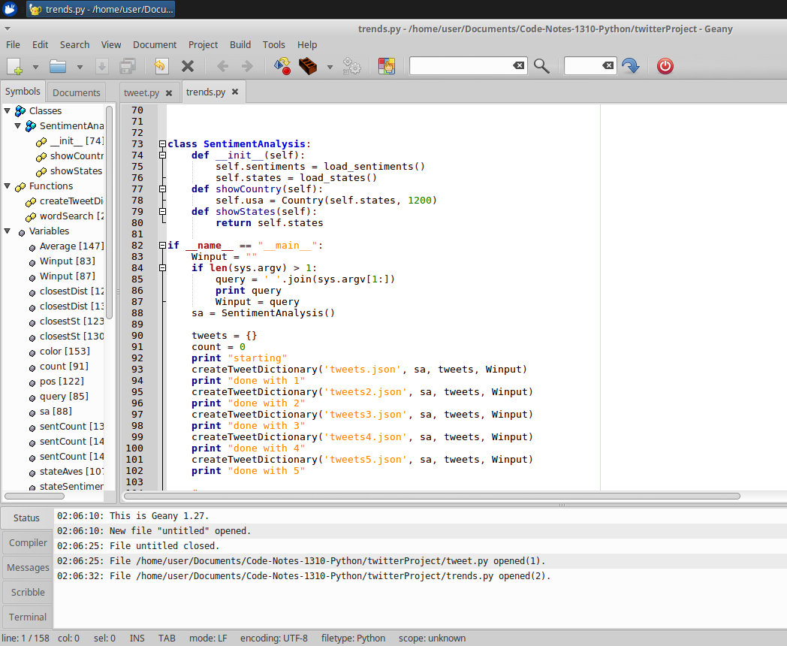
The code
Parsing the data

Slide 4
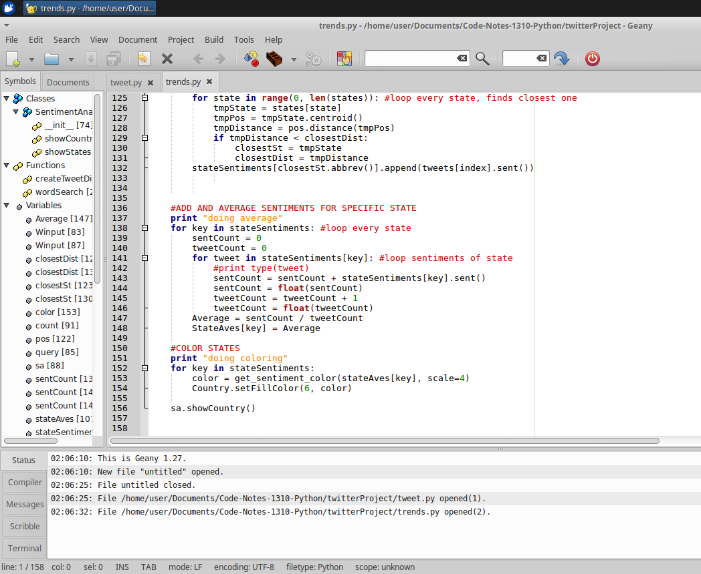

The code
Creating sentiment

Slide 5
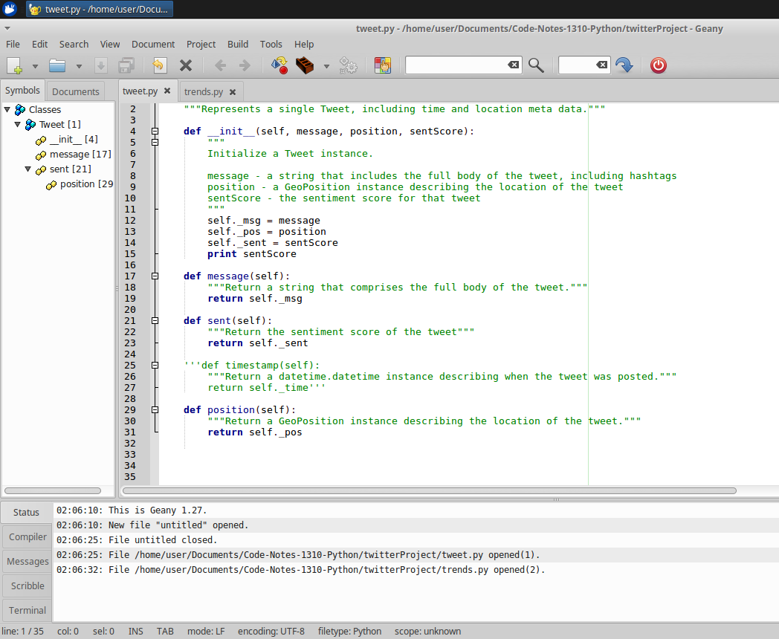
The code
Defining a tweet

Slide 6
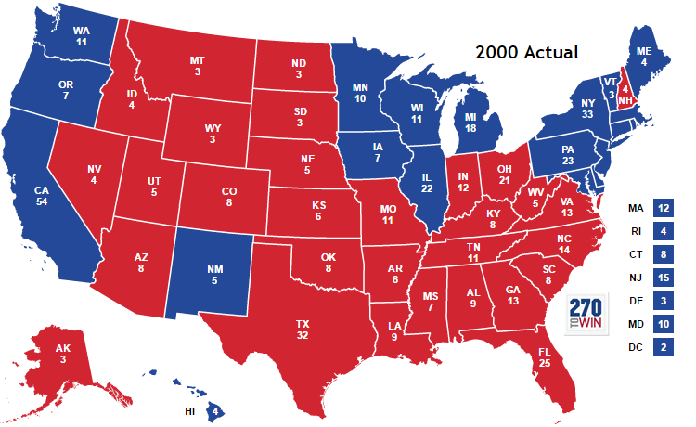
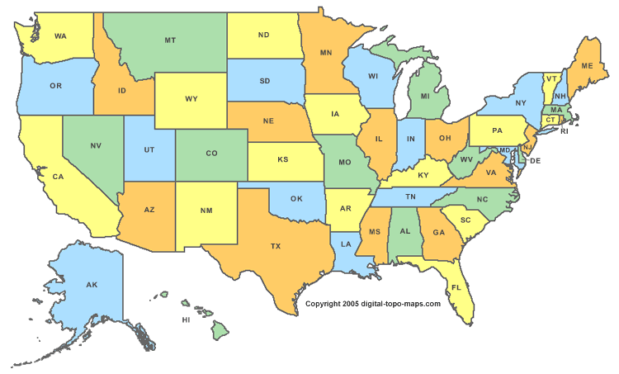
Results
Fun, interesting, useful tool to use

Slide 7
Lessons learned
Large code projects have to be done in steps
In depth coding in another language

